Slide 1
Intro to RDBMS and SQL
ISTA 322 - Data Engineering

Slide 2
RDBMS
Relational database management system
Relational is key
Series of tables that are related to one another
The values in one table have something to do with values in another
The connections between tables are the keys
Tables are… in table format
Row/column format

Slide 3
Table: artist_albums
artist_id | album_id | album_name | released
x88928 | a99189 | near_dark | 2019
x88928 | a73198 | the_shape | 2017
x88928 | a93018 | abyss | 2016
z99029 | a32201 | my_way | 1969
z99029 | a23812 | duets | 1993
z99029 | a83012 | thats_life | 1966
Three tables make up our named RDB:
spotify_db
Table: track_features
id | song_name | tempo | loudness | energy
a99189 | diabolic | 135 | 8.4 | 0.99
a73198 | invader | 122 | 7.5 | 0.92
a93018 | riot | 133 | 9.9 | 0.00
a32201 | summer wind | 95 | 3.2 | 0.22
a23812 | witchcraft | 68 | 2.2 | 0.15
a83012 | angel eyes | 70 | 4.8 | 0.05
Keys link tables
Table: artist_info
artist_name | artist_id | genre | followers
Dance w/t Dead | x88928 | synthwave | 156000
Frank Sinatra | z99029 | traditional | 12020900
ODESZA | i88010 | chillwave | 3987400

Slide 4
In contrast to just a table with all information.
Lots of redundancy
Lots of information you don’t need
Table: artist
artist_id | album_id | album_name | released | song_name | tempo | loudness | energy | genre | followers
x88928 | a99189 | near_dark | 2019 | diabolic | 135 | 8.4 | 0.99 | synthwave | 156000
x88928 | a73198 | the_shape | 2017 | invader | 122 | 7.5 | 0.92 | synthwave | 156000
x88928 | a93018 | abyss | 2016 | riot | 133 | 9.9 | 0.00 | synthwave | 156000
z99029 | a32201 | my_way | 1969 | summer wind | 95 | 3.2 | 0.22 | traditional | 12020900
z99029 | a23812 | duets | 1993 | witchcraft | 68 | 2.2 | 0.15 | traditional | 12020900
z99029 | a83012 | thats_life | 1966 | angel eyes | 70 | 4.8 | 0.05 | traditional | 12020900

Slide 5
RDBMS & SQL
SQL - Structured Query Language
‘Sequel’
‘S-Q-L’
The language used to work with a RDBMS
“Connect to the SQL DB” really means “Connect to the RDBMS”
There many RDBMS
MySQL, SQLite, MariaDB, Oracle, PostgreSQL, many more…
Each has its own strengths and weakness
And it’s own SQL syntax :(

Slide 6
SQL Syntax - But first
Your RDBMS can reside a lot of places
Could be on your local computer
Could be on a company server
Could be on the cloud
Lots goes into managing databases - not going to cover all here
Key thing for now is how to connect and interact

Slide 7
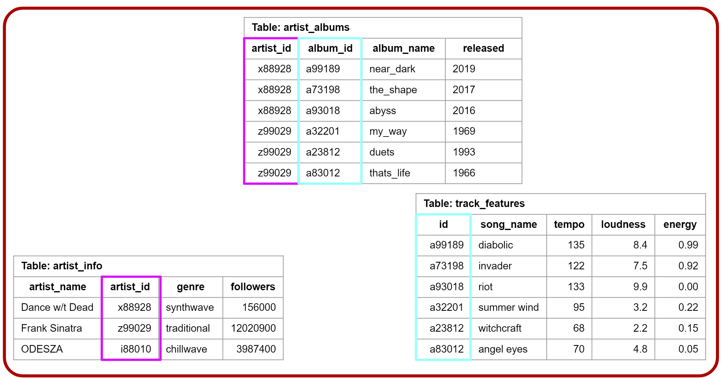
Working with a RDBMS Connect to RDBMS
RDB on AWS/local/server
To connect need credentials
Name
Host (location)
Username
Password
DB Manger controls acces, etc.
connection
Your computer

Slide 8
Working with a RDBMS Create cursor
RDB on AWS/local/server
Cursor allocates memory at the RDB
Memory allocation
connection
cursor
Your computer

Slide 9
Working with a RDBMS Fetch data using cursor
RDB on AWS/local/server
Cursor allocates memory at the RDB
Cursor object executes query
Memory allocation
connection
cursor
Your computer

Slide 10
Working with a RDBMS Fetch data using cursor
RDB on AWS/local/server
Cursor allocates memory at the RDB
Cursor object executes query
Cursor used to fetch results which are then displayed or stored locally
Memory allocation
connection
cursor
Your computer

Slide 11
Working with a RDBMS
RDB on AWS/local/server
It’s important to not leave connections and cursors open
Your functions should close them at the end!
connection
cursor
Your computer

Slide 12
SQL Syntax
After getting your connection and cursor you can write a query
Query is the statement of actions that you want to perform
SELECT, FROM, WHERE, GROUPBY...

Slide 13
Syntactical Order of Operations
SELECT
DISTINCT
AGGREGATIONS
FROM
WHERE
GROUP BY
HAVING
ORDER BY

Slide 14
Syntactical Order of Operations
SELECT
DISTINCT
AGGREGATIONS
FROM
WHERE
GROUP BY
HAVING
ORDER BY
Starting with the basics

Slide 15
Syntactical Order of Operations
SELECT
SELECT
DISTINCT
AGGREGATIONS
FROM
WHERE
GROUP BY
HAVING
ORDER BY
SELECT - Select the columns you want from a table
Call columns by names
Or call all using *
SELECT song_name, artist_id

Slide 16
SELECT
Table: top_track_features
artist_id | song_name | tempo | loudness | energy
x88928 | diabolic | 135 | 8.4 | 0.99
x88928 | invader | 122 | 7.5 | 0.92
x88928 | riot | 133 | 9.9 | 0.00
z99029 | summer wind | 95 | 3.2 | 0.22
z99029 | witchcraft | 68 | 2.2 | 0.15
z99029 | angel eyes | 70 | 4.8 | 0.05
SELECT - Select the columns you want from a table
Call columns by names
Or call all using *
SELECT song_name, artist_id

Slide 17
Syntactical Order of Operations
FROM
SELECT
DISTINCT
AGGREGATIONS
FROM
WHERE
GROUP BY
HAVING
ORDER BY
FROM - What table do you want the columns from?
Obviously weird to call this second… more on this later.
SELECT song_name, artist_id
FROM top_track_features

Slide 18
FROM
Table: top_track_features
artist_id | song_name | tempo | loudness | energy
x88928 | diabolic | 135 | 8.4 | 0.99
x88928 | invader | 122 | 7.5 | 0.92
x88928 | riot | 133 | 9.9 | 0.00
z99029 | summer wind | 95 | 3.2 | 0.22
z99029 | witchcraft | 68 | 2.2 | 0.15
z99029 | angel eyes | 70 | 4.8 | 0.05
FROM - What table do you want the columns from?
Obviously weird to call this second… more on this later.
SELECT song_name, artist_id
FROM top_track_features

Slide 19
Syntactical Order of Operations
WHERE
SELECT
DISTINCT
AGGREGATIONS
FROM
WHERE
GROUP BY
HAVING
ORDER BY
WHERE - allows you to filter rows by condition
Comparison
= > < <>(not)
SELECT song_name, artist_id
FROM top_track_features
WHERE artist_id = ‘x88928’

Slide 20
WHERE
Table: top_track_features
artist_id | song_name | tempo | loudness | energy
x88928 | diabolic | 135 | 8.4 | 0.99
x88928 | invader | 122 | 7.5 | 0.92
x88928 | riot | 133 | 9.9 | 0.00
z99029 | summer wind | 95 | 3.2 | 0.22
z99029 | witchcraft | 68 | 2.2 | 0.15
z99029 | angel eyes | 70 | 4.8 | 0.05
WHERE - allows you to filter rows by condition
Comparison
= > < <>(not)
SELECT song_name, artist_id
FROM top_track_features
WHERE artist_id = ‘x88928’

Slide 21
WHERE
Table: top_track_features
artist_id | song_name | tempo | loudness | energy
x88928 | diabolic | 135 | 8.4 | 0.99
x88928 | invader | 122 | 7.5 | 0.92
x88928 | riot | 133 | 9.9 | 0.00
z99029 | summer wind | 95 | 3.2 | 0.22
z99029 | witchcraft | 68 | 2.2 | 0.15
z99029 | angel eyes | 70 | 4.8 | 0.05
WHERE - allows you to filter rows by condition
Comparison
= > < <>(not)
SELECT song_name, artist_id
FROM top_track_features
WHERE tempo < 100

Slide 22
WHERE
Table: top_track_features
artist_id | song_name | tempo | loudness | energy
x88928 | diabolic | 135 | 8.4 | 0.99
x88928 | invader | 122 | 7.5 | 0.92
x88928 | riot | 133 | 9.9 | 0.00
z99029 | summer wind | 95 | 3.2 | 0.22
z99029 | witchcraft | 68 | 2.2 | 0.15
z99029 | angel eyes | 70 | 4.8 | 0.05
WHERE - allows you to filter rows by condition
Comparison
= > < <>(not)
Logical
IN LIKE NOT...
SELECT loudness, tempo
FROM top_track_features
WHERE artist_id LIKE ‘x8%’

Slide 23
Syntactical Order of Operations
GROUP BY
SELECT
DISTINCT
AGGREGATIONS
FROM
WHERE
GROUP BY
HAVING
ORDER BY
GROUP BY - Allows you to apply aggregation functions to columns for each grouping level
SELECT AVG(tempo)
FROM top_track_features
GROUP BY artist_id

